Slide 1
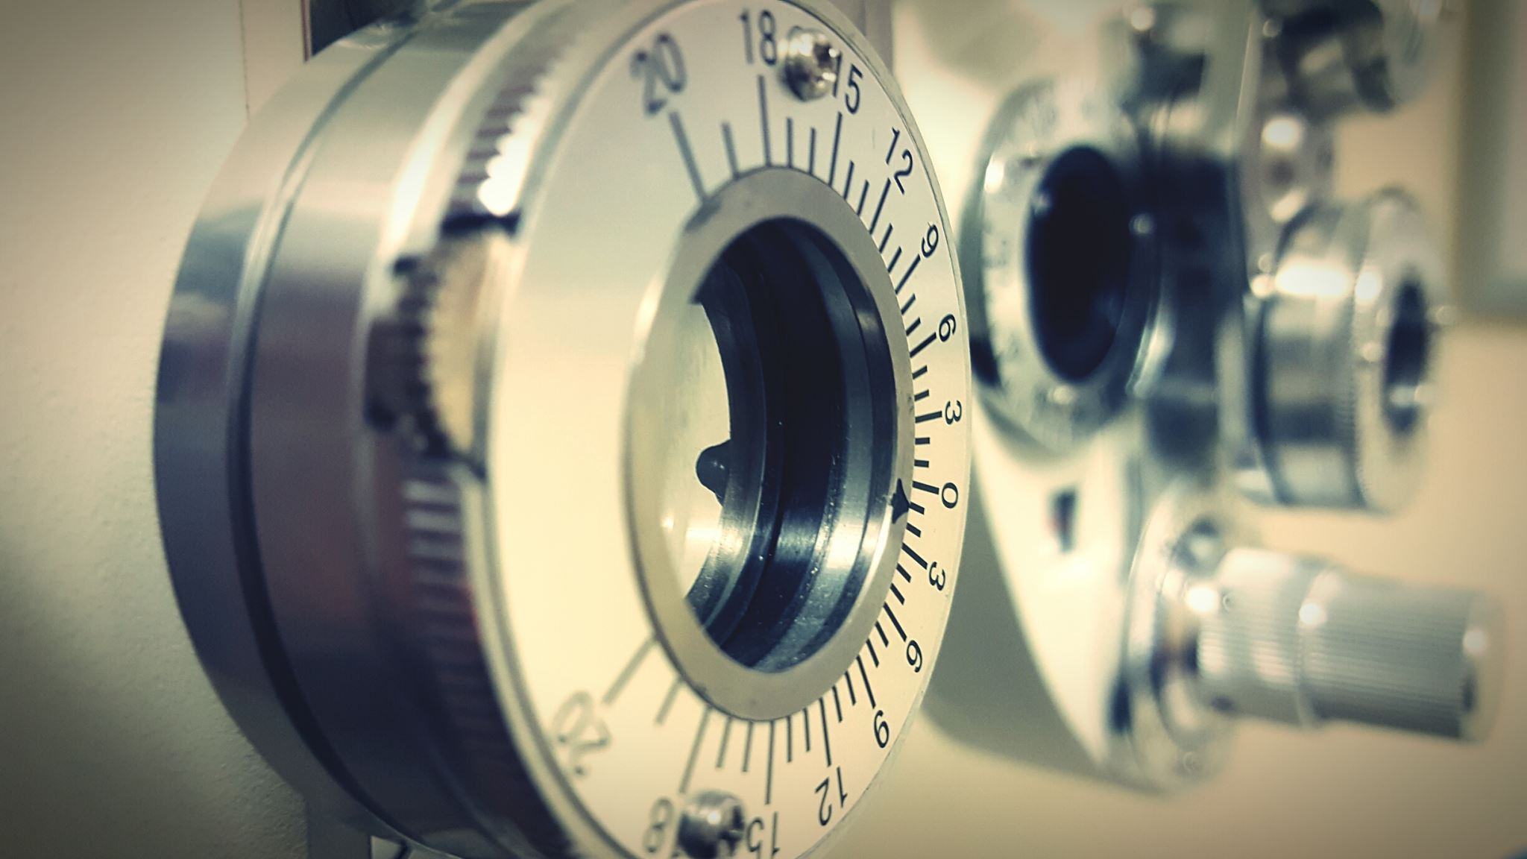
Thermostat system
Vlad Veliciu

Slide 2

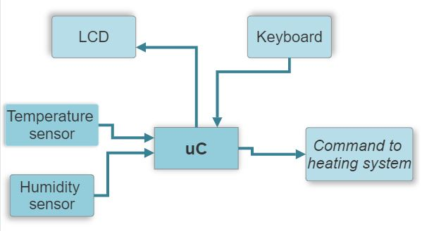
Block diagram

Slide 3
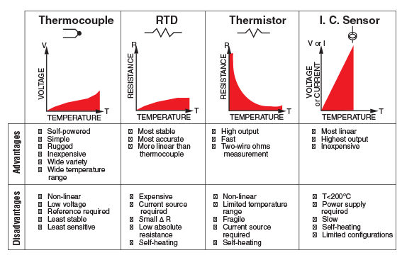
Types of temperature sensors

Slide 4
Semiconductor-based IC temperature sensor
No. | Name | Temp range (°C) | Gain (mV/°C) | Supply voltage (V) | Supply current when measuring (µA) | Accuracy (°C) | Price (RON)
1. | TMP236AQDBZRQ1 | -10 +125 | 19.5 | 3.1…5.5 | 14.5 | +/-2.5 | 6.53
2. | MAX6611AUT+T | -40 +125 | 16 | 4.5…5.5 | 150 | +/-1 | 23.51
3. | MAX6605MXK+T | -55 +125 | 11.9 | 2.7…5.5 |  | +/-0.75 | 10.00
4. | TMP235A2DBZR | -40 +150 | 10 | 2.3…5.5 | 15 | +/-0.5 | 6.93
5. | LMT70YFQT | -55 +150 | 5.194 | 2.2…5.5 | 12 | +/-0.2°C | 12.73

Slide 5
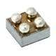
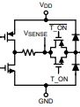
Semiconductor-based IC temperature sensor
LMT70YFQT
an ultra-small, high-precision, low-power CMOS analog temperature sensor

Slide 6
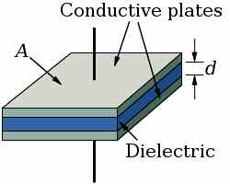

Types of humidity sensors
1. Capacitive
Thin strip of hygroscopic polymer film as dielectric
$C=ε∗\frac{A}{d}$
The dielectric dependent to the relative humidity

Slide 7
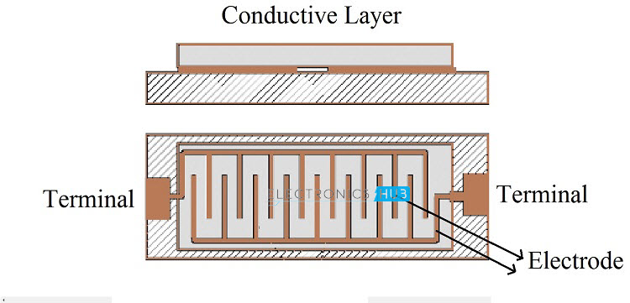
Types of humidity sensors
2. Resistive
Materials with low resistivity that varies inverse proportional with humidity
Used materials: salt, conductive polymeres

Slide 8
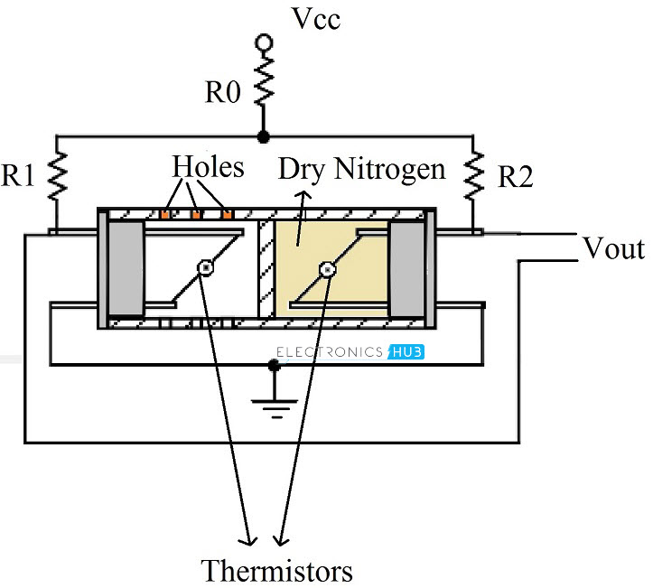
Types of humidity sensors
3. Thermal conductivity
2 thermistors are used
Measures conductivity of dry air and air with water vapors and the difference = absolute humidity

Slide 9
Capacitive humidity sensor
No. | Name | Range (% RH) | Supply voltage (V) | Supply current when measuring (µA) | Accuracy (% RH) | Price (RON)
1. | SHT40-AD1B-R3 | 0 100 | 1.08…3.6 | 320 | +/-1.8 | 12.57
2. | DHT11 | 20 90 | 3…5 | 500 | +/-5 | 10.85
3. | SHT31-DIS-B2.5kS | 0 100 | 2.4…5.5 | 600 | +/-2 | 24.21
4. | HS3004 | 0 100 | 3.3…5.5 | 7 | +/-3.5 | 12.23
5. | HS3001 | 0 100 | 3.3…5.5 | 24.4 | +/-1.5 | 32.92

Slide 10
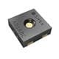
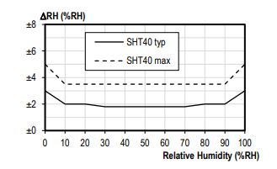
Capacitive humidity sensor
SHT40-AD1B-R3

Slide 11
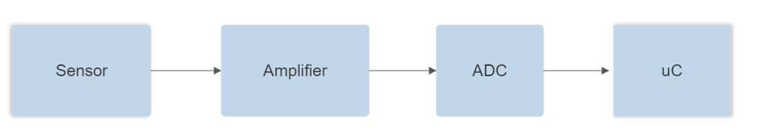
Connecting the analog temperature sensor - Required elements

Slide 12
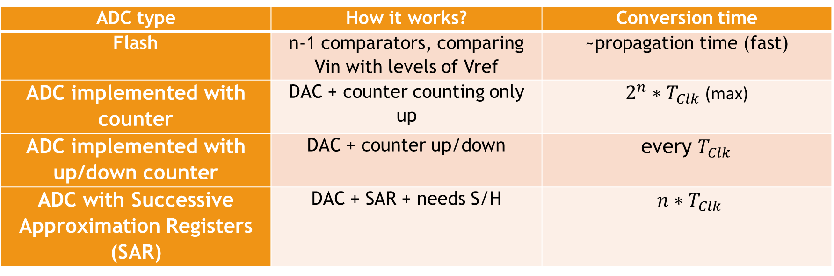
Types of ADC
ADC type | How it works? | Conversion time
Flash | n-1 comparators, comparing Vin with levels of Vref | ~propagation time (fast)
ADC implemented with counter | DAC + counter counting only up | $2^{n}∗T_{Clk}$ (max)
ADC implemented with up/down counter | DAC + counter up/down | every $T_{Clk}$
ADC with Successive Approximation Registers (SAR) | DAC + SAR + needs S/H | $n∗T_{Clk}$

Slide 13
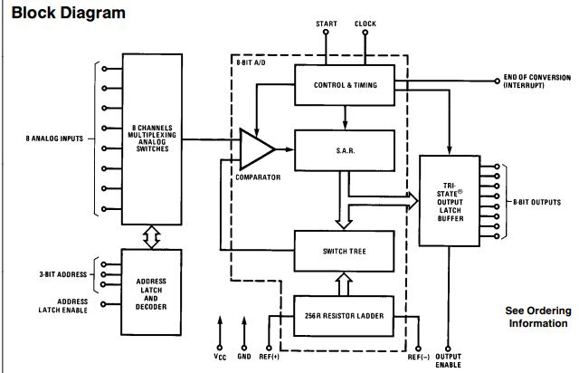
ADC0808
Characteristics:
Conversion time: 100 µs
Voltage Supply: 4.5V … 6V (typical 5V) (VREF + = 5V and VREF - = 0V)
Total error: +/- 0.5 LSB
Clock frequency: 640 kHz

Slide 14
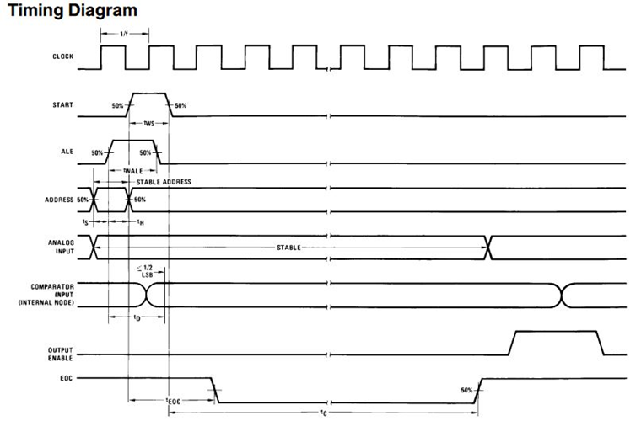
ADC0808
START = start of conversion
EOC = end of conversion
OE = output enable

Slide 15
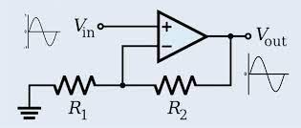

Amplification needed?
$V_{LSB}=\frac{V_{FS}}{2^{N}}=\frac{V_{Ref}}{2^{8}}=20mV (0.0195V)$
Sensor LM45: gain of 10 mV/°C
At 0°C => Vout=0V and at 50°C => Vout=0,5V
ADC: At 0°C => Out=0h and at 50°C => Out=FFh (255; 255*VLSB=Vin => Vin=4,99V)
Conclusion: Amplification is needed (A=4,99/0,5=9,98)
=> Choose an Operational Amplifier

Slide 16
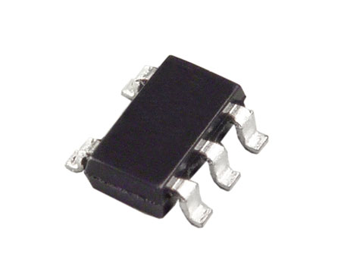
AD8603
Characteristics:
Low offset voltage: 50µV
Single-supply operation: 5V
Precision amplifier
High CMRR: 100dB
Rail-to-rail

Slide 17
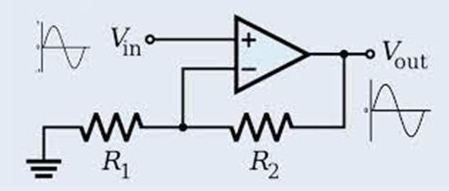

Non-inverting amplifier
$$A=1+\frac{R_{2}}{R_{1}}=9.98$$
$R_{2}=8.98∗R_{1}$
$take R_{1}=1kΩ and R_{2}=8.98kΩ$

Slide 18
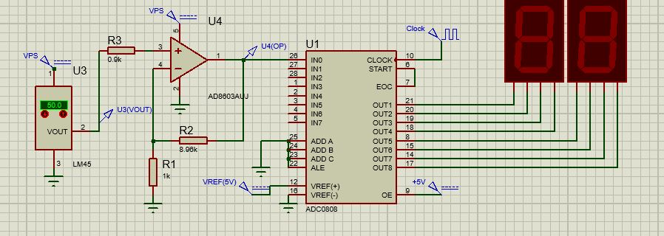

Implementing in Proteus
$$Vout_{opamp}=N∗V_{LSB}=>N=\frac{Vout_{opamp}}{V_{LSB}}$$

Slide 19
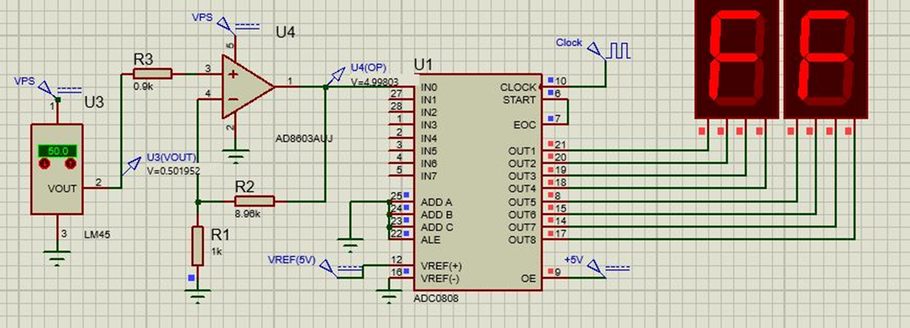
Implementing in Proteus: case 50°C

Slide 20
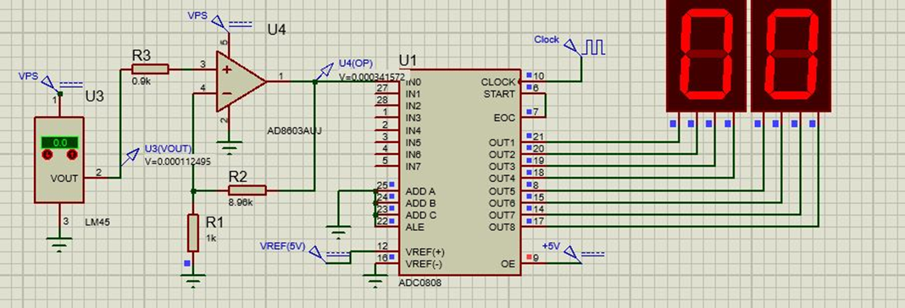
Implementing in Proteus: case 0°C

Slide 21
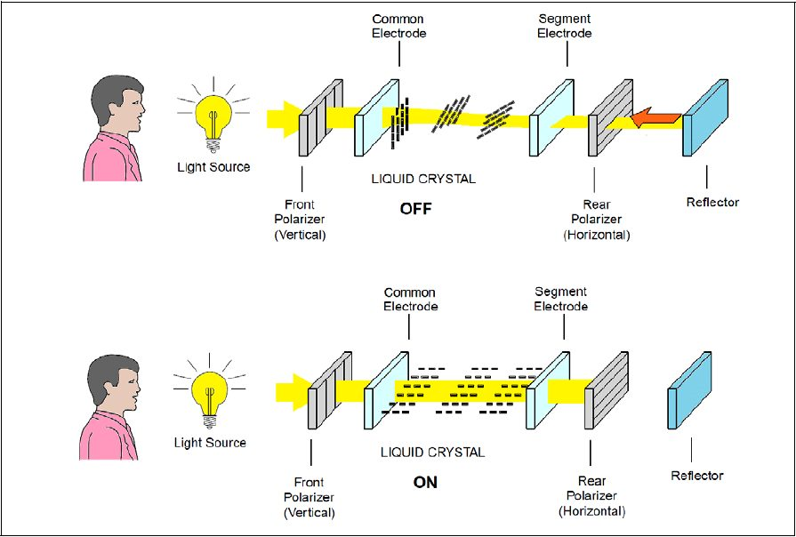
How does the LCD work?
2 polarized panel filters and electrodes
Principle of blocking light
Working:
Current applied to liquid crystal molecule
Molecule tends to untwist
Angle of light changes
Angle of polarizing filter changes
-> that area becomes blank

Slide 22
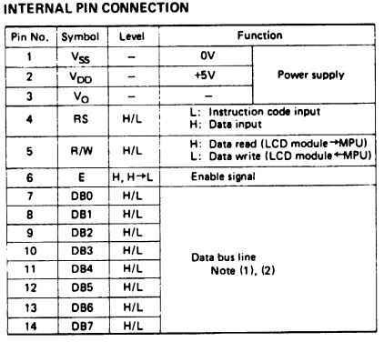
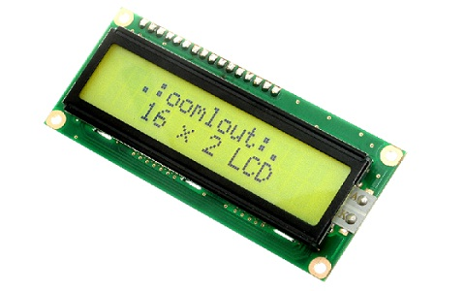
How does the LCD work?
HD44780U standard communication
Chosen LCD: LM016L (16x2 display)
Signals:
RS: 0 (command), 1 (information)
RW: 0 (write), 1 (read)
EN: low when setting other lines, put in high for a min period of time (230 ns for writing), then in low again
D0…D7: data lines

Slide 23
Commands for the LCD
Instruction | RS | R/W | D7 |  | D6 |  | D5 |  | D4 |  | D3 |  | D2 |  | D1 |  | D0 | Hex code (D7…D0)
16x2 LCD (init) | 0 | 0 | 0 |  | 0 |  | 1 |  | 1 |  | 1 |  | 0 |  | 0 |  | 0 | 38h
Place cursor | 0 | 0 | 0 |  | 0 |  | 0 |  | 0 |  | 1 |  | 1 |  | 1 |  | 0 | 0Eh
Clear display | 0 | 0 | 0 |  | 0 |  | 0 |  | 0 |  | 0 |  | 0 |  | 0 |  | 1 | 01h
Write a character | 1 | 0 | ASCII code for the character (D0=LSB and D7=MSB)
Move cursor on line 2 | 0 | 0 | 1 | 1 |  | 0 |  | 0 |  | 0 |  | 0 |  | 0 |  | 0 |  | C0h
Move cursor on line 1 | 0 | 0 | 1 | 0 |  | 0 |  | 0 |  | 0 |  | 0 |  | 0 |  | 0 |  | 80h
Cursor off | 0 | 0 | 0 | 0 |  | 0 |  | 0 |  | 1 |  | 1 |  | 0 |  | 0 |  | 0Ch
Display off, cursor off | 0 | 0 | 0 | 0 |  | 0 |  | 0 |  | 1 |  | 0 |  | 0 |  | 0 |  | 8h
After setting the signals for every instruction, the EN signal needs to be put from LOW to HIGH, then after the minimum period again in LOW.

Slide 24
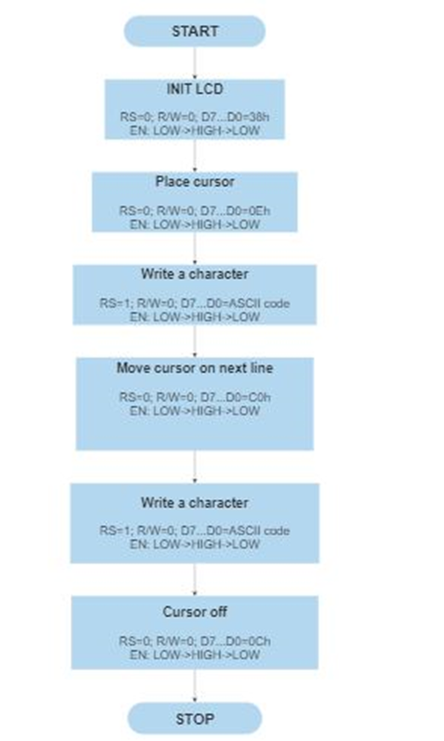
Writing on the LCD
Instr | RS | R/W | D7 | D6 | D5 | D4 | D3 | D2 | D1 | D0
Init LCD | 0 | 0 | 0 | 0 | 1 | 1 | 1 | 0 | 0 | 0
Cursor on | 0 | 0 | 0 | 0 | 0 | 0 | 1 | 1 | 1 | 0
V | 1 | 0 | 0 | 1 | 0 | 1 | 0 | 1 | 1 | 0
L | 1 | 0 | 0 | 1 | 0 | 0 | 1 | 1 | 0 | 0
A | 1 | 0 | 0 | 1 | 0 | 0 | 0 | 0 | 0 | 1
D | 1 | 0 | 0 | 1 | 0 | 0 | 0 | 1 | 0 | 0
New line | 0 | 0 | 1 | 1 | 0 | 0 | 0 | 0 | 0 | 0
V | 1 | 0 | 0 | 1 | 0 | 1 | 0 | 1 | 1 | 0
E | 1 | 0 | 0 | 1 | 0 | 0 | 0 | 1 | 0 | 1
L | 1 | 0 | 0 | 1 | 0 | 0 | 1 | 1 | 0 | 0
I | 1 | 0 | 0 | 1 | 0 | 0 | 1 | 0 | 0 | 1
C | 1 | 0 | 0 | 1 | 0 | 0 | 0 | 0 | 1 | 1
I | 1 | 0 | 0 | 1 | 0 | 0 | 1 | 0 | 0 | 1
U | 1 | 0 | 0 | 1 | 0 | 1 | 0 | 1 | 0 | 1
Cursor off | 0 | 0 | 0 | 0 | 0 | 0 | 1 | 1 | 0 | 0

Slide 25
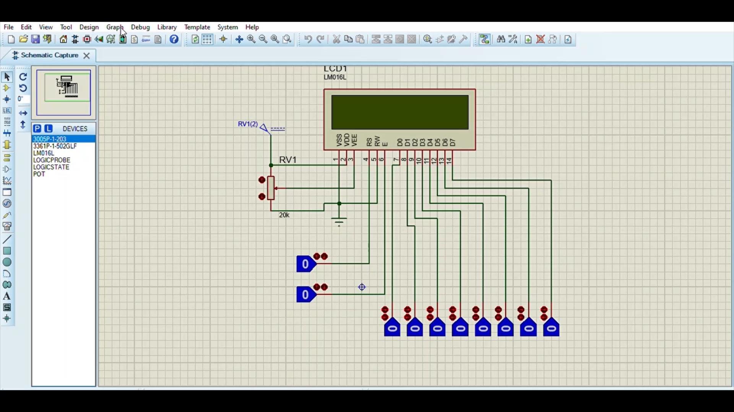
Writing on the LCD

Slide 26
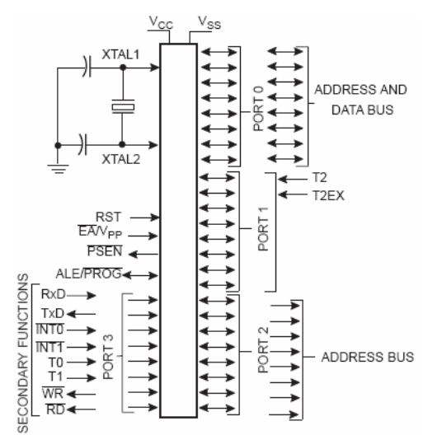
Choosing the Microcontroller (80C51 family)
Main characteristics (usually):
4kB internal ROM
128B internal RAM
Some signals:
ALE/PROG
PSEN: external program memory read strobe
EA (External Access Enable)/Vpp:
EA low -> external memory code
EA high -> internal memory code

Slide 27
Microcontrollers from the 80C51 familiy
No. | Name | RAM size | ROM size | Voltage range (V) | Clock frequency (MHz) | I/O ports | ADC intern | Price (RON)
1. | C8051F986-C-GU | 512x8 | 8kx8 | 1.8…3.6 | 25 | 17 | yes | 16.53
2. | AT89LP828-20AU | 768x8 | 8kx8 | 2.4…5.5 | 20 | 30 | no | 15.15
3. | AT89LP51RB2-20JU | 256x8 | 24kx8 | 2.4…5.5 | 20 | 40 | yes | 19.85
4. | AT89LP51-20JU | 256x8 | 4kx8 | 2.4…5.5 | 20 | 36 | no | 17.08
5. | AT89LP51RB2-20AU | 256x8 | 24kx8 | 2.4…5.5 | 20 | 40 | yes | 18.96

Slide 28
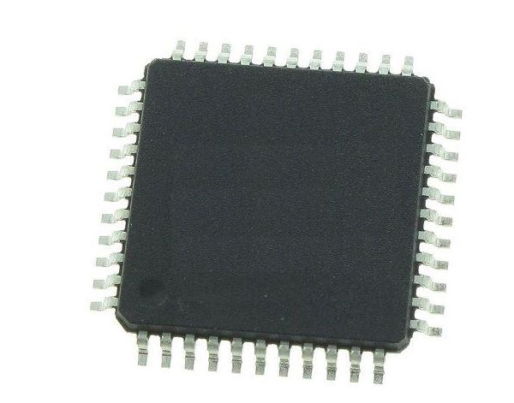
The AT89LP51RB2-20AU microcontroller

Slide 29
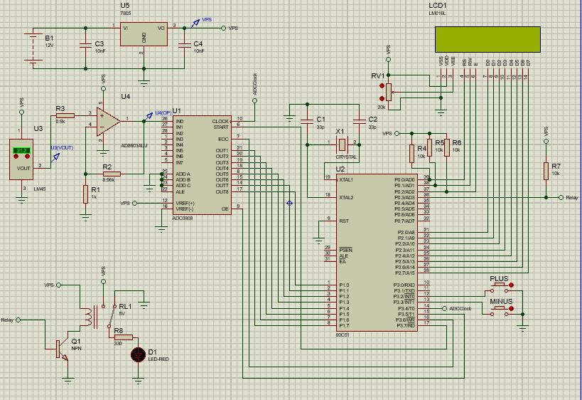
Complete electrical schematic in Proteus

Slide 30
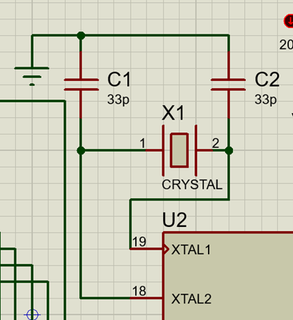
Crystal oscillator
Between XTAL1 XTAL2, inverting amplifier
Capacitors ensure phase stability + frequency selection from the crystal oscillator

Slide 31
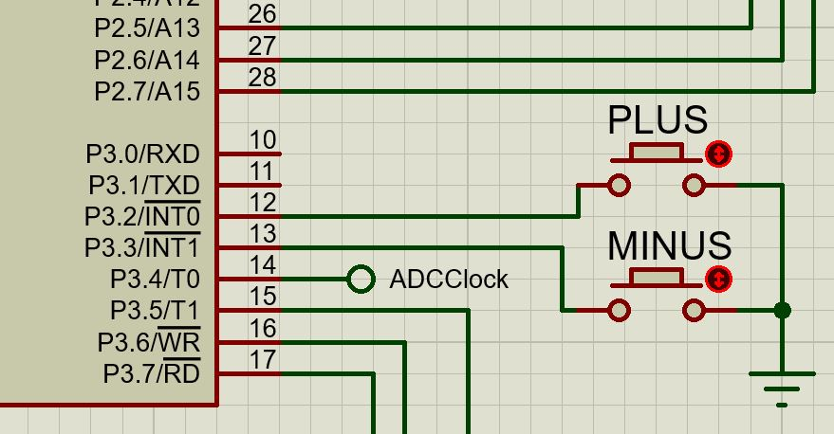
Buttons
PLUS Button on external interrupt INT0
MINUS on INT1

Slide 32
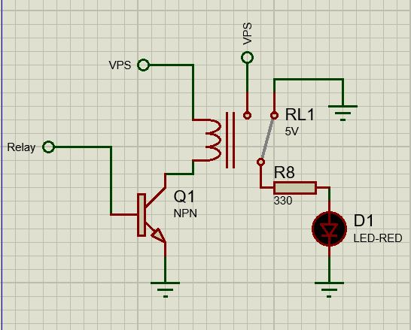
Relay
Output ‘1’ from uC => transistor ON => current flow => metallic arch pushed towards the coil with magnetic core
Output ‘0’ => metallic arch pushed away

Slide 33
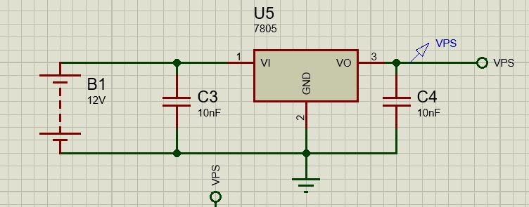
Voltage Regulator
Gives at output 5V to supply the electronic devices
Decoupling capacitors for eliminating the noise

Slide 34
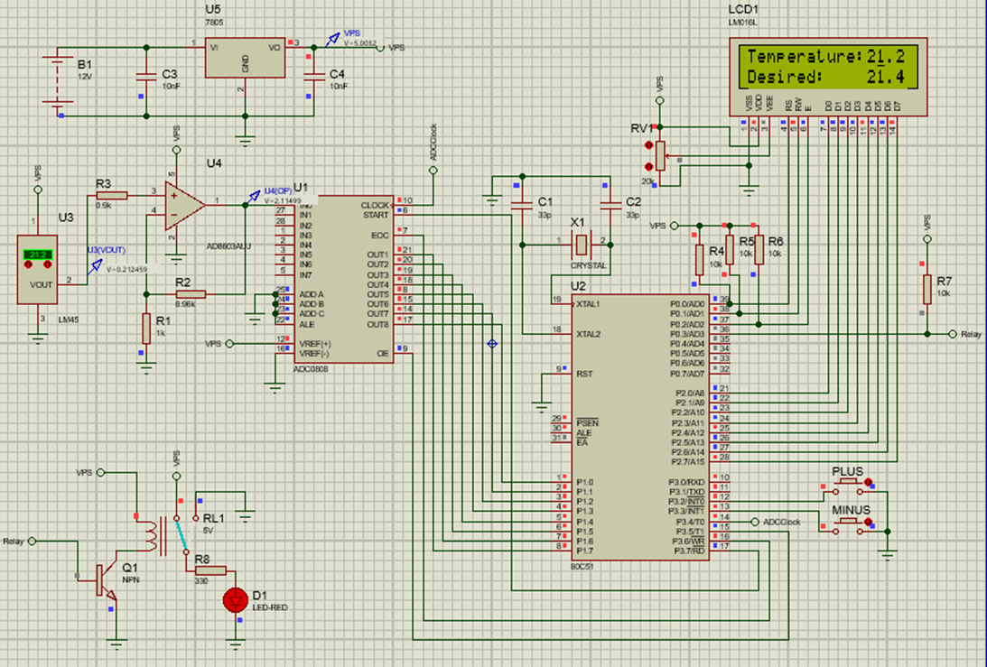
Simulation

